Slide 1
Prudential Life Insurance Advances in Data Science and Architecture Professor: Dr. Subrata Das
Shiqi Dai [001819581]
Shweta Tatiya [001814724]
Dharak Savalia [001219064]
Rohini Mandewalkar [001235482]

Slide 2
Project Overview
AIM:
Based on the applicant data, predict the risk levels(range 1-8) to make decisions on the insurance approval.
APPROACH:
We are pre-processing the data to build predictive models.
Building predictive models using linear regression, decision tree regression and SVM regression techniques.
Evaluating and comparing the performance of each model using test data

Slide 3
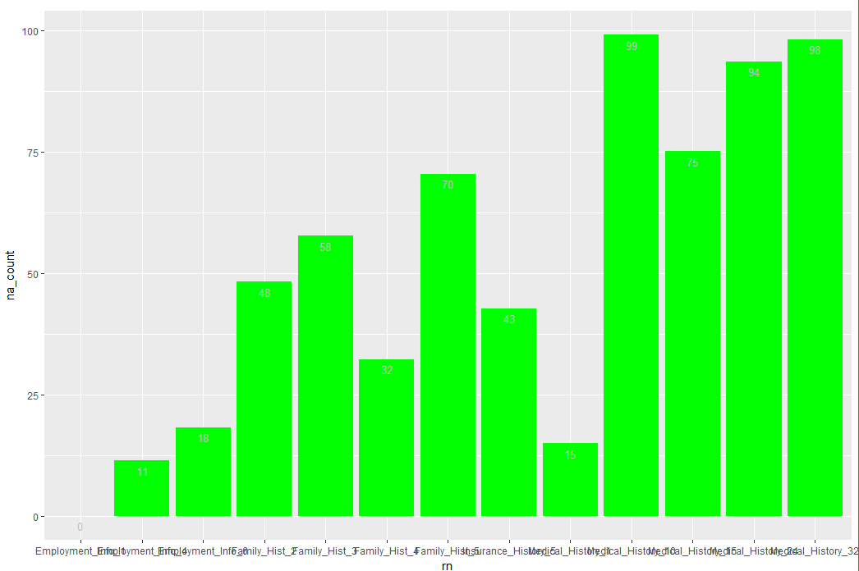
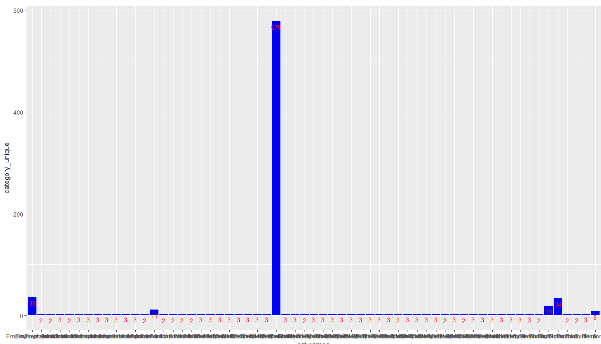
Pre-Processing of Data
Given:
The Prudential life insurance dataset has 127 independent variables and 1 dependent variables with over 58000 records. These 128 features are either continuous, discrete or categorical in nature.
Data Cleaning:
Eliminated the dimensions containing more than 60% of missing values.
Removed the dimensions having more than 6 categories.

Slide 4
Pre-Processing of Data
Data Imputation:
Imputed the missing values with the mean for continuous or discrete variables.
0 to C Transformation:
Categorical variables are converted to numerical(binary) by 0 to C transformation technique using ‘acm.disjonctif’ function in R.
Dimension Reduction:
We used linear regression to reduce the dimensions. The dimensions with Pr value more than 0.05 were taken off as they were less significant.

Slide 5
Linear regression
In statistics, linear regression is an approach for modeling the relationship between a scalar dependent variable y and one or more explanatory variables (or independent variables) denoted X.

Slide 6
Linear regression

Slide 7
Linear regression

Slide 8
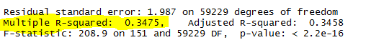

Linear regression

Slide 9
SVM regression
Support Vector Machines are very specific class of algorithms, characterized by usage of kernels, absence of local minima, sparseness of the solution and capacity control obtained by acting on the margin, or on number of support vectors, etc.

Slide 10
Tuning and Building SVM model
Tuning with radial kernel resulted in better performance, so the model was built with kernel as ‘radial’, cost as 10 and gamma as 0.5.

Slide 11
SVM regression

Slide 12


DECISION TREE REGRESSION
the form of a tree structure. It brakes down a dataset into smaller and smaller subsets while at the same time an associated decision tree is incrementally developed. The final result is a tree with decision nodes and leaf nodes.

Slide 13
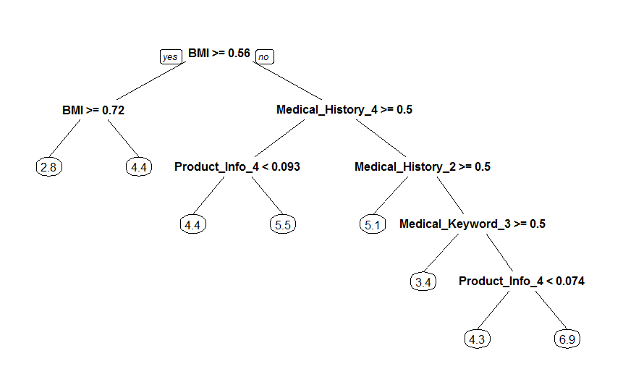
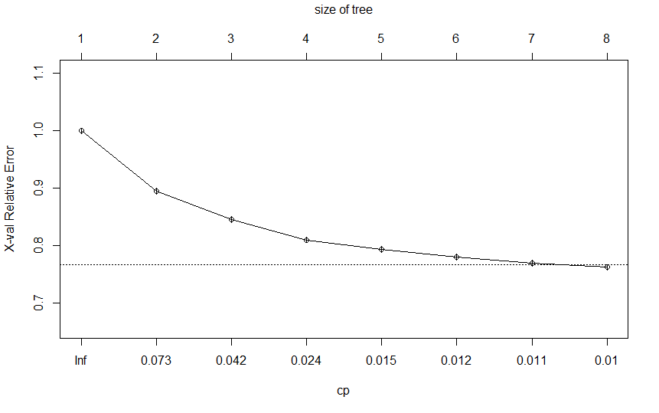
DECISION TREE REGRESSION

Slide 14

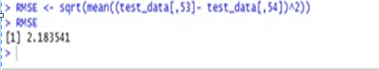
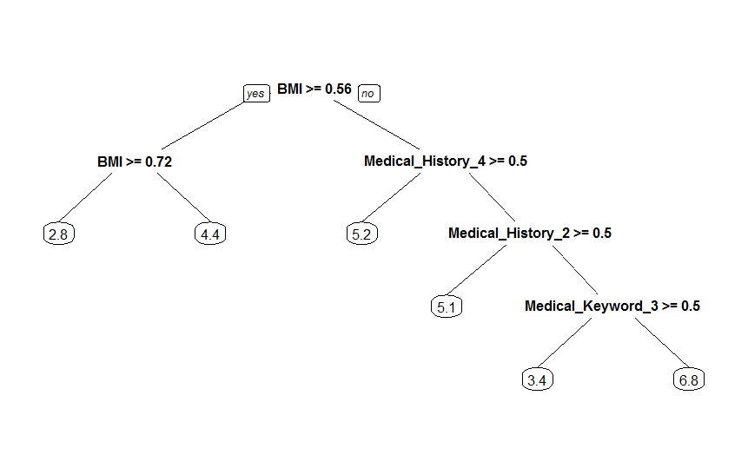
DECISION TREE REGRESSION

Slide 15
XGBoost
XGBoost (Extreme Gradient Boosting) is an optimized distributed gradient boosting library which is used for supervised ML problems. It uses gradient boosting (GBM) framework at core but does much better than GBM framework alone. XGBoost belongs to a family of boosting algorithms that convert weak learners into strong learners. A weak learner is one which is slightly better than random guessing. Boosting is a sequential process and slowly learns from data and tries to improve its prediction in subsequent iterations.
XGBoost parameters can be divided into three categories:
General Parameters: Controls the booster type in the model which eventually drives overall functioning - Booster, nthread
Booster Parameters: Controls the performance of the selected booster - Nrounds, lambda alpha
Learning Task Parameters: Sets and evaluates the learning process of the booster from the given data - Objective

Slide 16
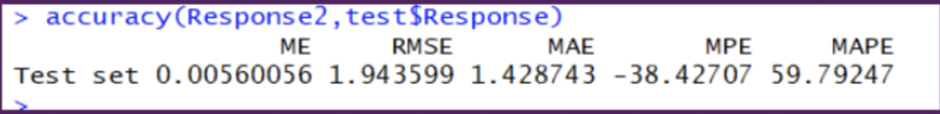
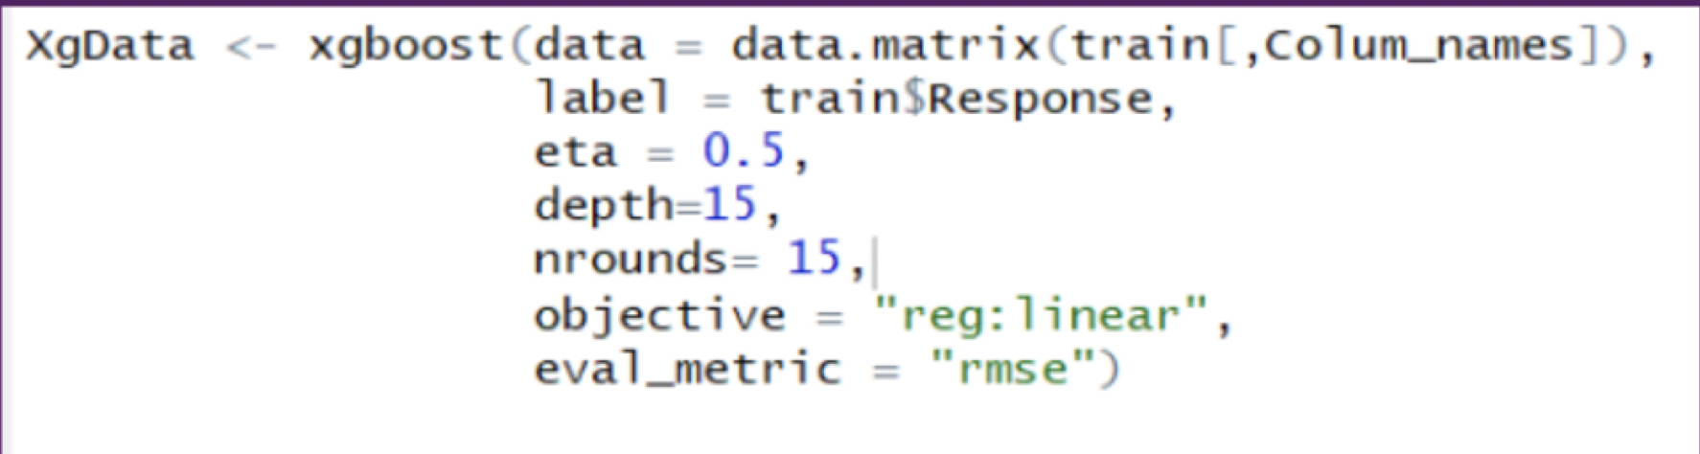
Code Snippet

Slide 17
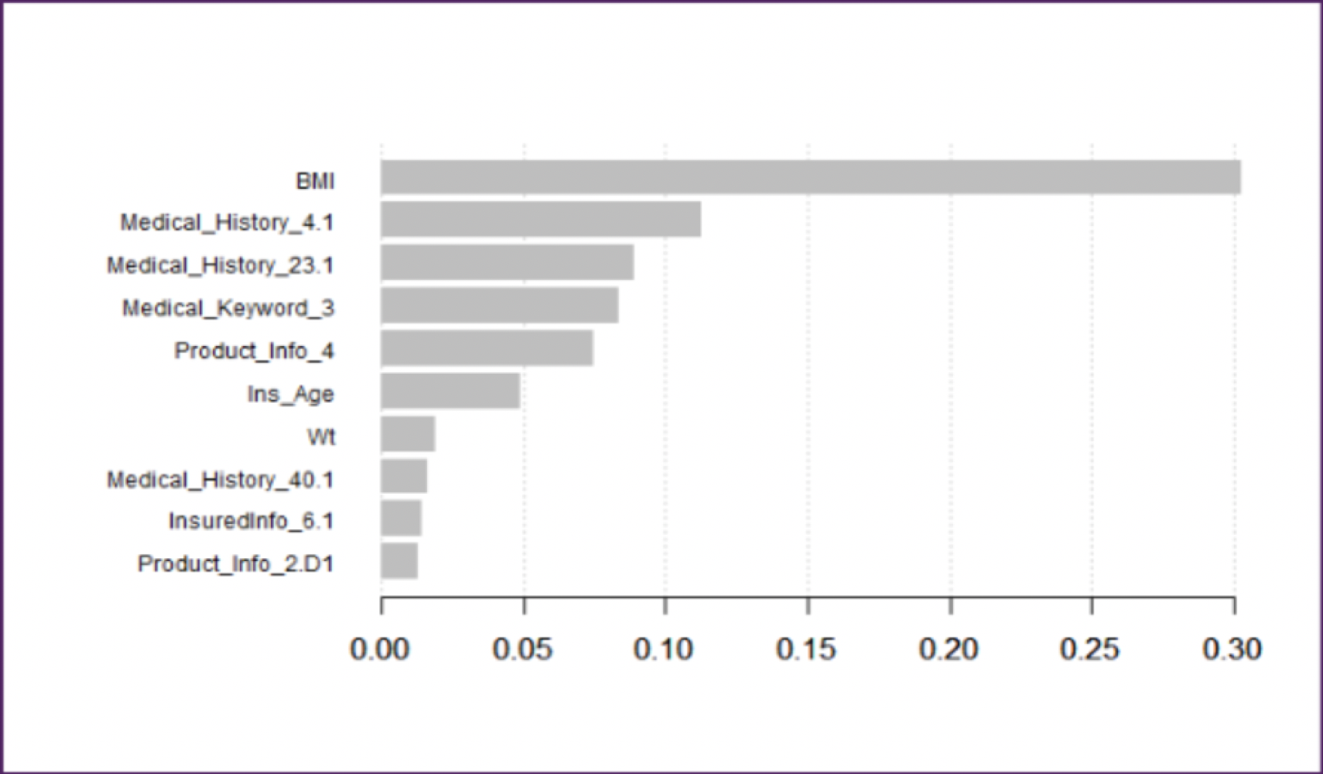
Plot

Slide 18
Based on the regression models implemented, we found out that the RMSE value of XGBoost was the lowest of all which was 1.94
Conclusion

Slide 19

Thank you

